Slide 1

Chapter 1
Introduction
Prof. Dr. Md Zahidul Islam
Dept of Computer Science and Engineering
1.<number>
Copyright © The McGraw-Hill Companies, Inc. Permission required for reproduction or display.
Notes:
1.#

Slide 2
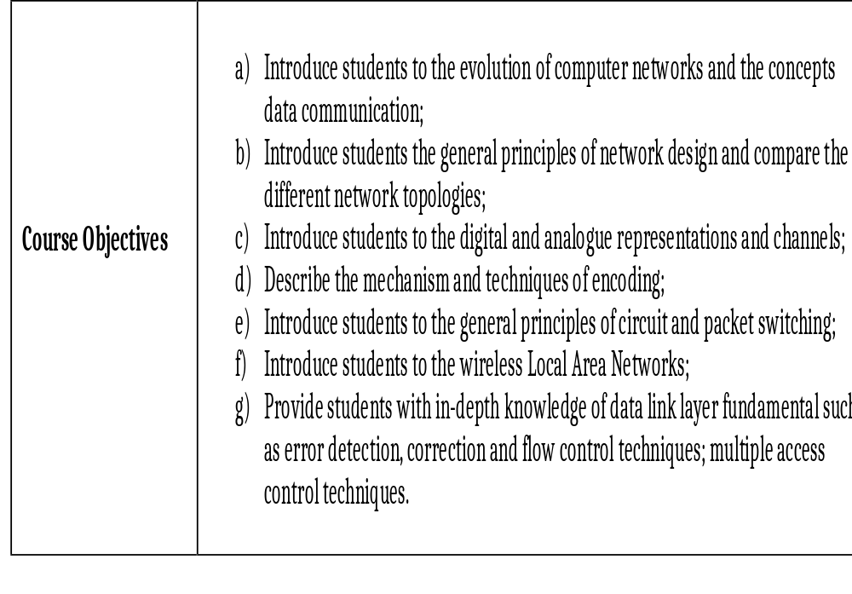
Course Objectives
1.<number>

Slide 3
Learning Outcomes
Learning Outcomes | Independently understand basic computer network technology. Understand and explain Data Communications System and its components. Identify the different types of network topologies and protocols. Enumerate the layers of the OSI model and TCP/IP. Explain the function(s) of each layer. Identify the different types of network devices and their functions within a network Understand and building the skills of subnetting and routing mechanisms. Familiarity with the basic protocols of computer networks, multiple access protocols, protocols to avoid collusion and how they can be used to assist in network design and implementation.
1.<number>

Slide 4
Teaching Methods
Teaching Methods | Lectures Presentations (when necessary) Group discussions (when necessary) Individual assignments and presentations
1.<number>

Slide 5
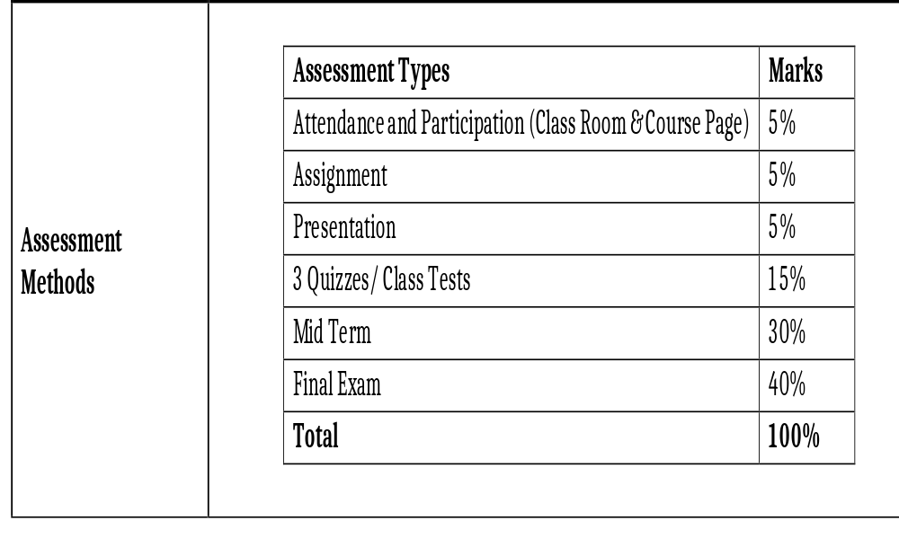
1.<number>

Slide 6
1-1 DATA COMMUNICATIONS
The term telecommunication means communication at a distance. The word data refers to information presented in whatever form is agreed upon by the parties creating and using the data. Data communications are the exchange of data between two devices via some form of transmission medium such as a wire cable.
Topics discussed in this section:
Components of a data communications system
Data Flow
1.<number>
Notes:
1.#

Slide 7

Figure 1.1 Components of a data communication system
1.<number>
Notes:
1.#

Slide 8

Figure 1.2 Data flow (simplex, half-duplex, and full-duplex)
1.<number>
Notes:
1.#

Slide 9
1-2 NETWORKS
A network is a set of devices (often referred to as nodes) connected by communication links. A node can be a computer, printer, or any other device capable of sending and/or receiving data generated by other nodes on the network. A link can be a cable, air, optical fiber, or any medium which can transport a signal carrying information.
Topics discussed in this section:
Network Criteria
Physical Structures
Categories of Networks
1.<number>
Notes:
1.#

Slide 10
Network Criteria
Performance
  Depends on Network Elements
  Measured in terms of Delay and Throughput
Reliability
  Failure rate of network components
  Measured in terms of availability/robustness
Security
  Data protection against corruption/loss of data due to:
      Errors
      Malicious users
1.<number>
Notes:
1.#

Slide 11
_x0010_Physical Structures
Type of Connection
  Point to Point - single transmitter and receiver
  Multipoint - multiple recipients of single transmission
Physical Topology
  Connection of devices
  Type of transmission - unicast, mulitcast, broadcast
1.<number>
Notes:
1.#

Slide 12

Figure 1.3 Types of connections: point-to-point and multipoint
1.<number>
Notes:
1.#

Slide 13

Figure 1.4 Categories of topology
1.<number>
Notes:
1.#

Slide 14

Figure 1.5 A fully connected mesh topology (five devices)
1.<number>
Notes:
1.#

Slide 15

Figure 1.6 A star topology connecting four stations
1.<number>
Notes:
1.#

Slide 16

Figure 1.7 A bus topology connecting three stations
1.<number>
Notes:
1.#

Slide 17

Figure 1.8 A ring topology connecting six stations
1.<number>
Notes:
1.#

Slide 18

Figure 1.9 A hybrid topology: a star backbone with three bus networks
1.<number>
Notes:
1.#

Slide 19
_x0010_Categories of Networks
Local Area Networks (LANs)
  Short distances
  Designed to provide local interconnectivity
Wide Area Networks (WANs)
  Long distances
  Provide connectivity over large areas
Metropolitan Area Networks (MANs)
  Provide connectivity over areas such as a city, a campus
1.<number>
Notes:
1.#

Slide 20

Figure 1.10 An isolated LAN connecting 12 computers to a hub in a closet
1.<number>
Notes:
1.#

Slide 21

Figure 1.11 WANs: a switched WAN and a point-to-point WAN
1.<number>
Notes:
1.#

Slide 22

Figure 1.12 A heterogeneous network made of four WANs and two LANs
1.<number>
Notes:
1.#

Slide 23
1-3 THE INTERNET
The Internet has revolutionized many aspects of our daily lives. It has affected the way we do business as well as the way we spend our leisure time. The Internet is a communication system that has brought a wealth of information to our fingertips and organized it for our use.
Topics discussed in this section:
Organization of the Internet
Internet Service Providers (ISPs)
1.<number>
Notes:
1.#

Slide 24

Figure 1.13 Hierarchical organization of the Internet
1.<number>
Notes:
1.#

Slide 25
1-4 PROTOCOLS
A protocol is synonymous with rule. It consists of a set of rules that govern data communications. It determines what is communicated, how it is communicated and when it is communicated. The key elements of a protocol are syntax, semantics and timing
Topics discussed in this section:
Syntax
Semantics
Timing
1.<number>
Notes:
1.#

Slide 26
_x0010_Elements of a Protocol
Syntax
  Structure or format of the data
  Indicates how to read the bits - field delineation
Semantics
  Interprets the meaning of the bits
  Knows which fields define what action
Timing
  When data should be sent and what
  Speed at which data should be sent or speed at which it is being received.
1.<number>
Notes:
1.#

